Slide 1
jacklouispt
Unlock Your Potential, Embrace Your Fitness Journey
Terry Huang, JACK LOUIS PT LIMITED

Slide 2


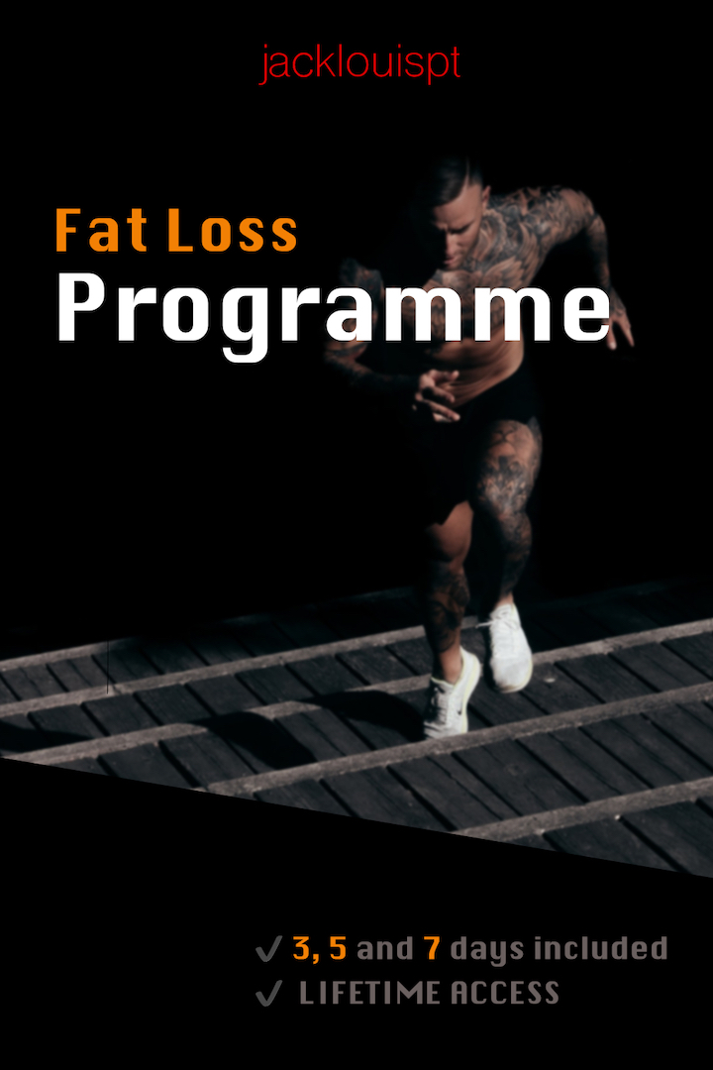

Website Objectives
Promote and sell Fat Loss and Muscle Growth Packages One payment. Multiple 3, 4 and 5 day programmes.
Allow users to enrol on programmes under their purchased package
Explanation Videos
Calorie Calculator
Private 1-1 Programmes (Coming Later)
Progress Tracking
Accessible Demonstrations
Meal Plans

Slide 3
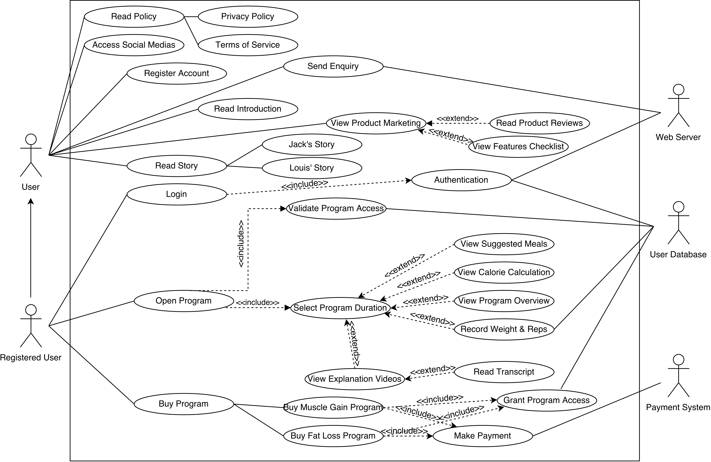
UML Use Case Diagram

Slide 4
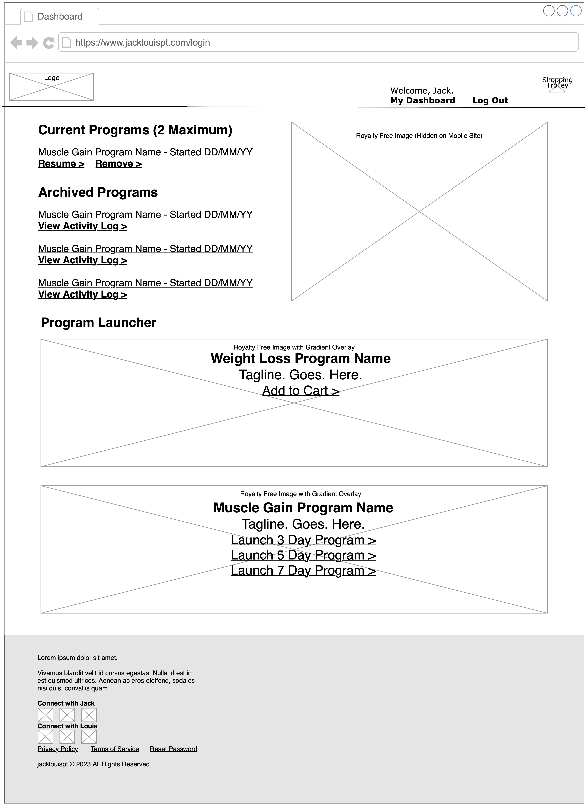
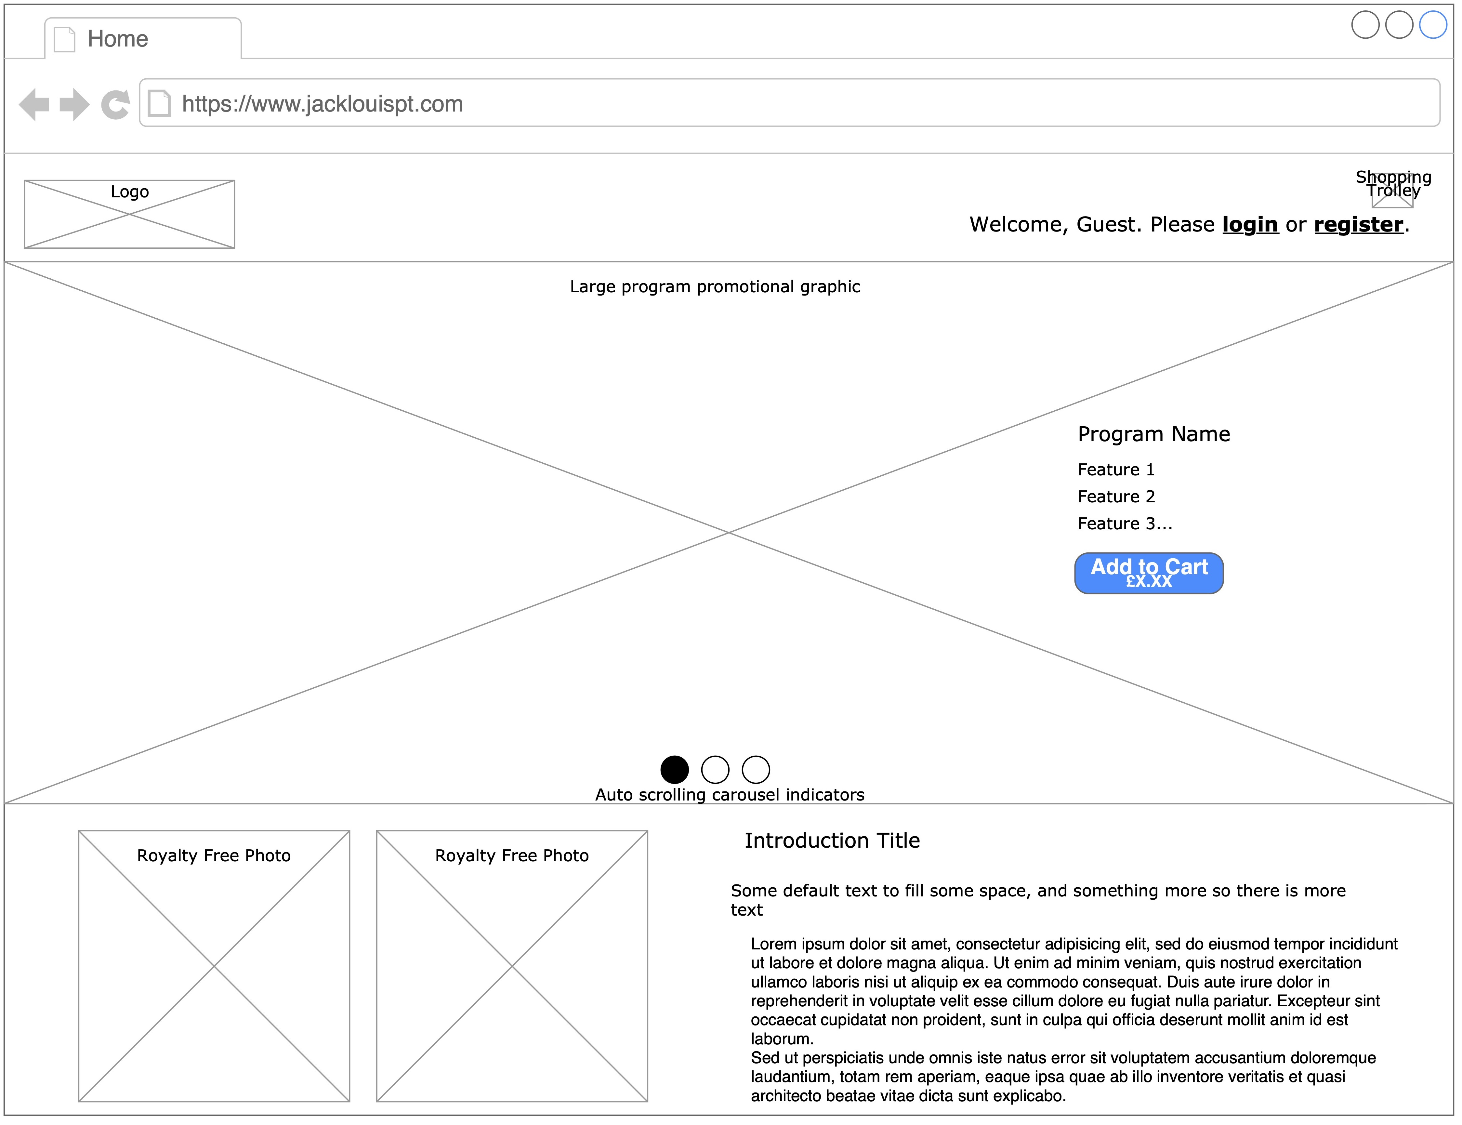
Wireframe Design

Slide 5
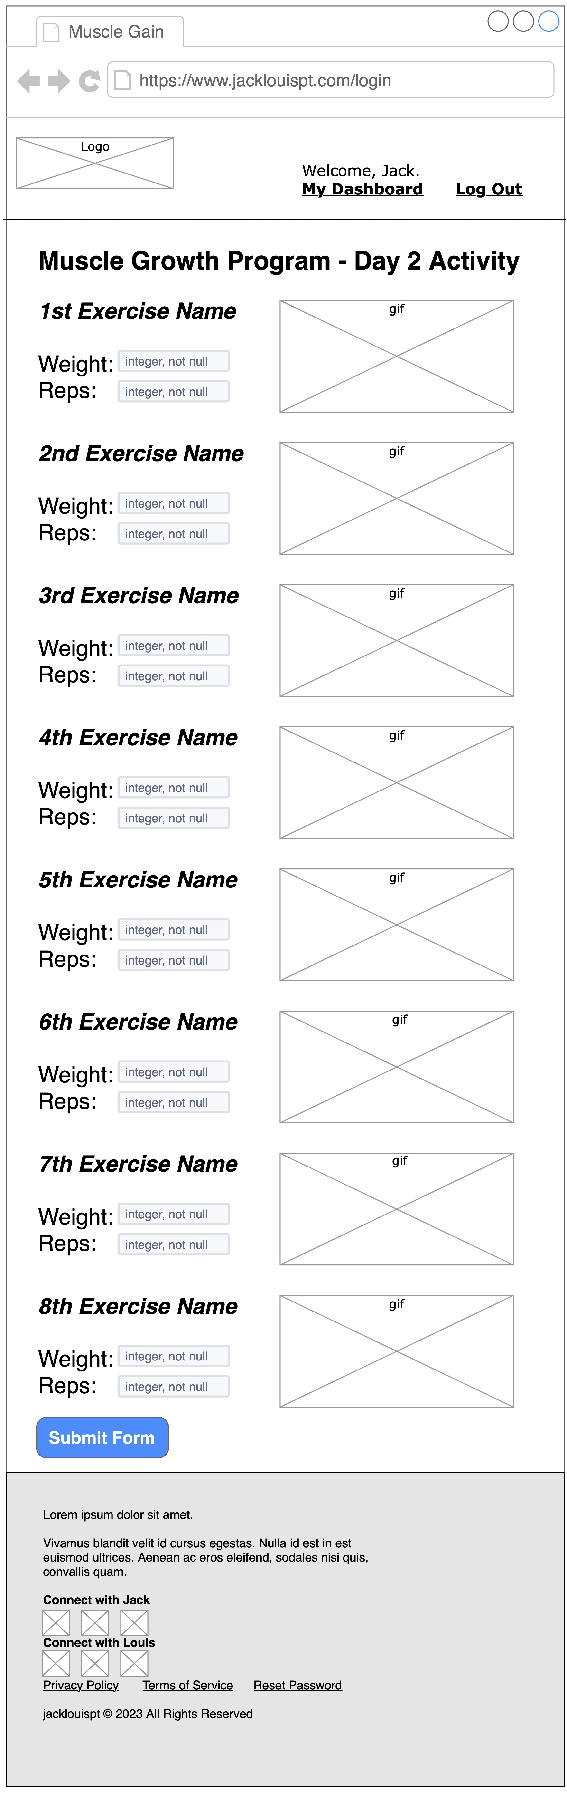
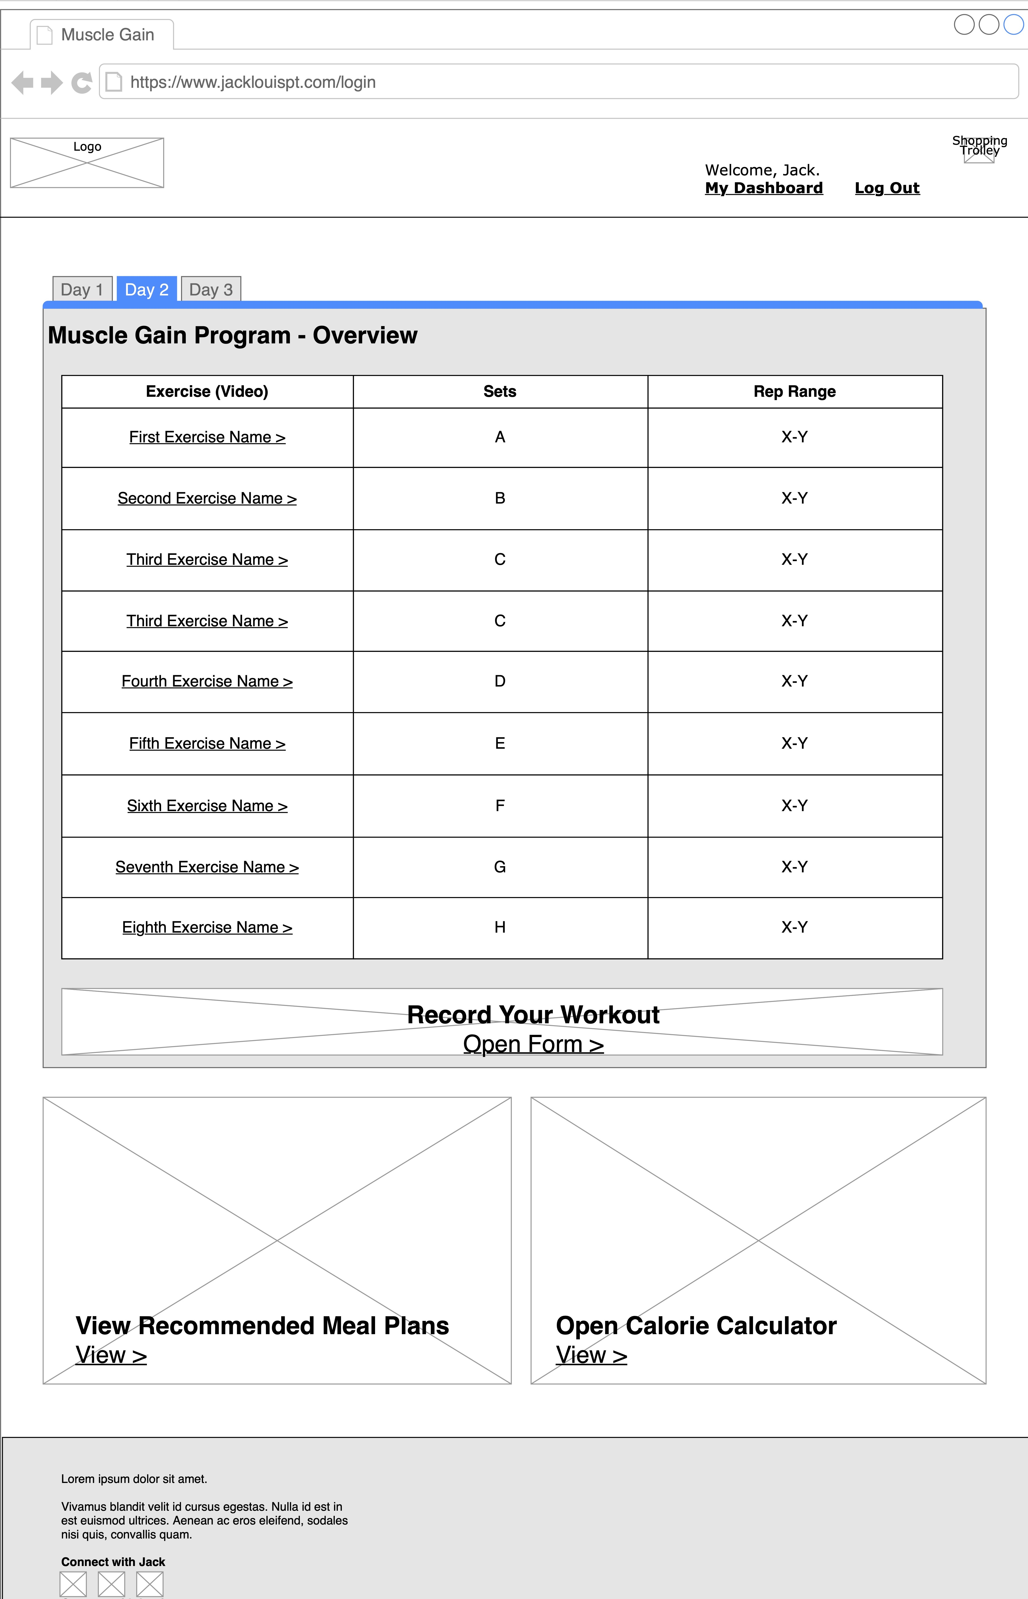
Wireframe Design Cntd…

Slide 6
Wireframe Design Cntd…

Slide 7
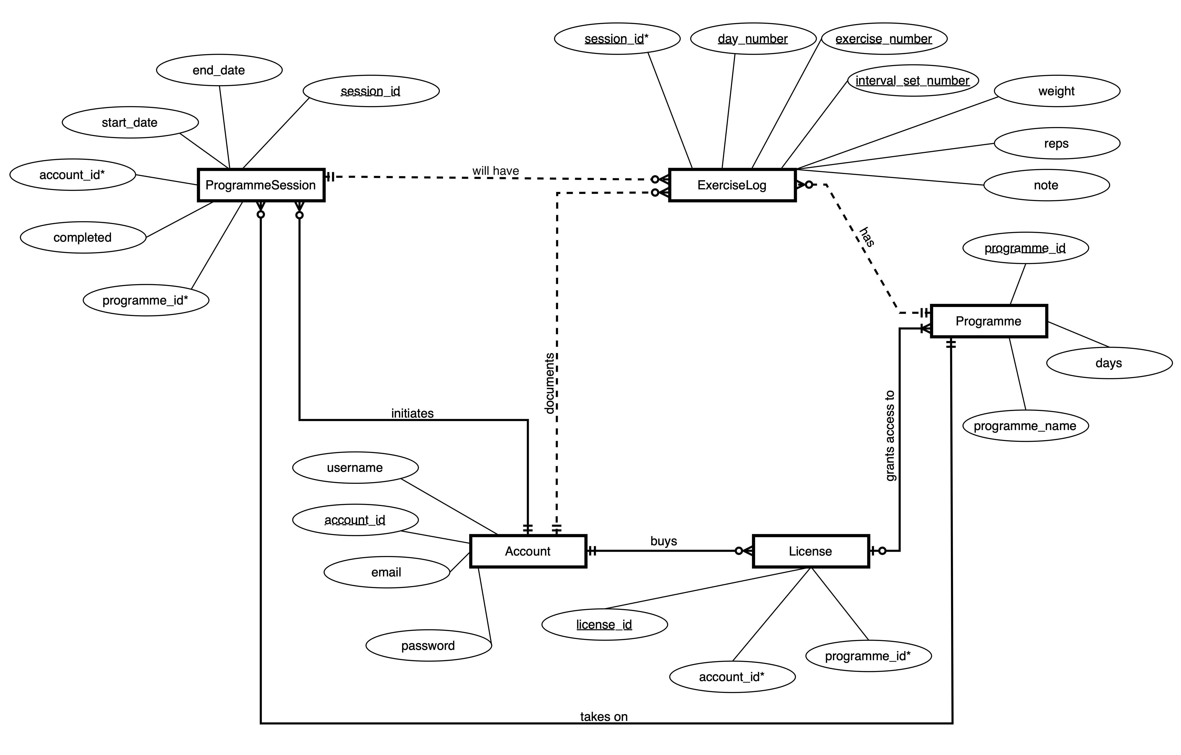
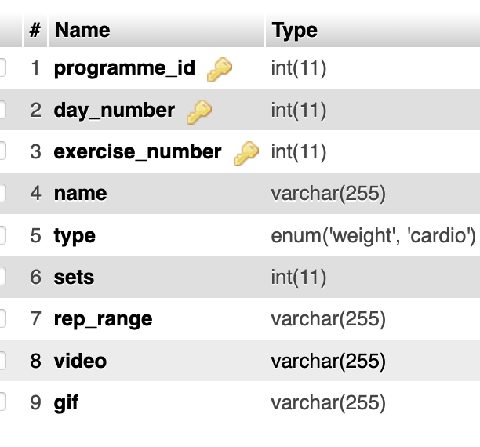
Database Entity Relationship Diagram
Refinements & Changes That Were Made:
Added a “Product” table and referenced its Primary Key from the “License” table
Added an “Exercise” table. Each exercise is uniquely identified by its associated programme_id, day_number and indexed exercise_number for that day
Proposed Design

Slide 8
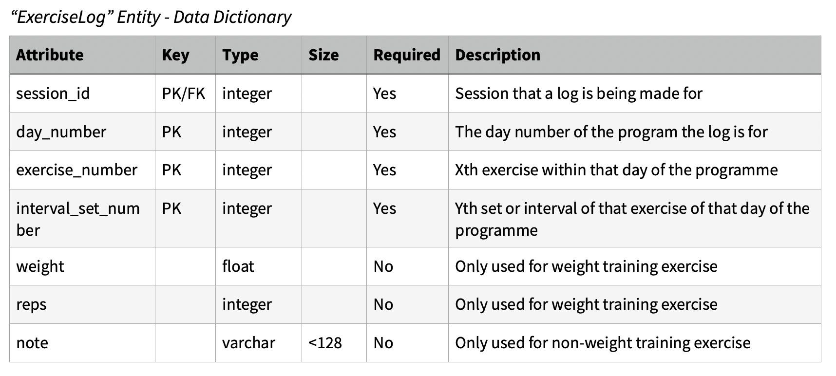

Slide 9
Privacy & Security Implementations
SQL Prepared Statements
Data Validation & Sanitisation
Hashed Passwords
Checks to ensure a user is logged in

Slide 10
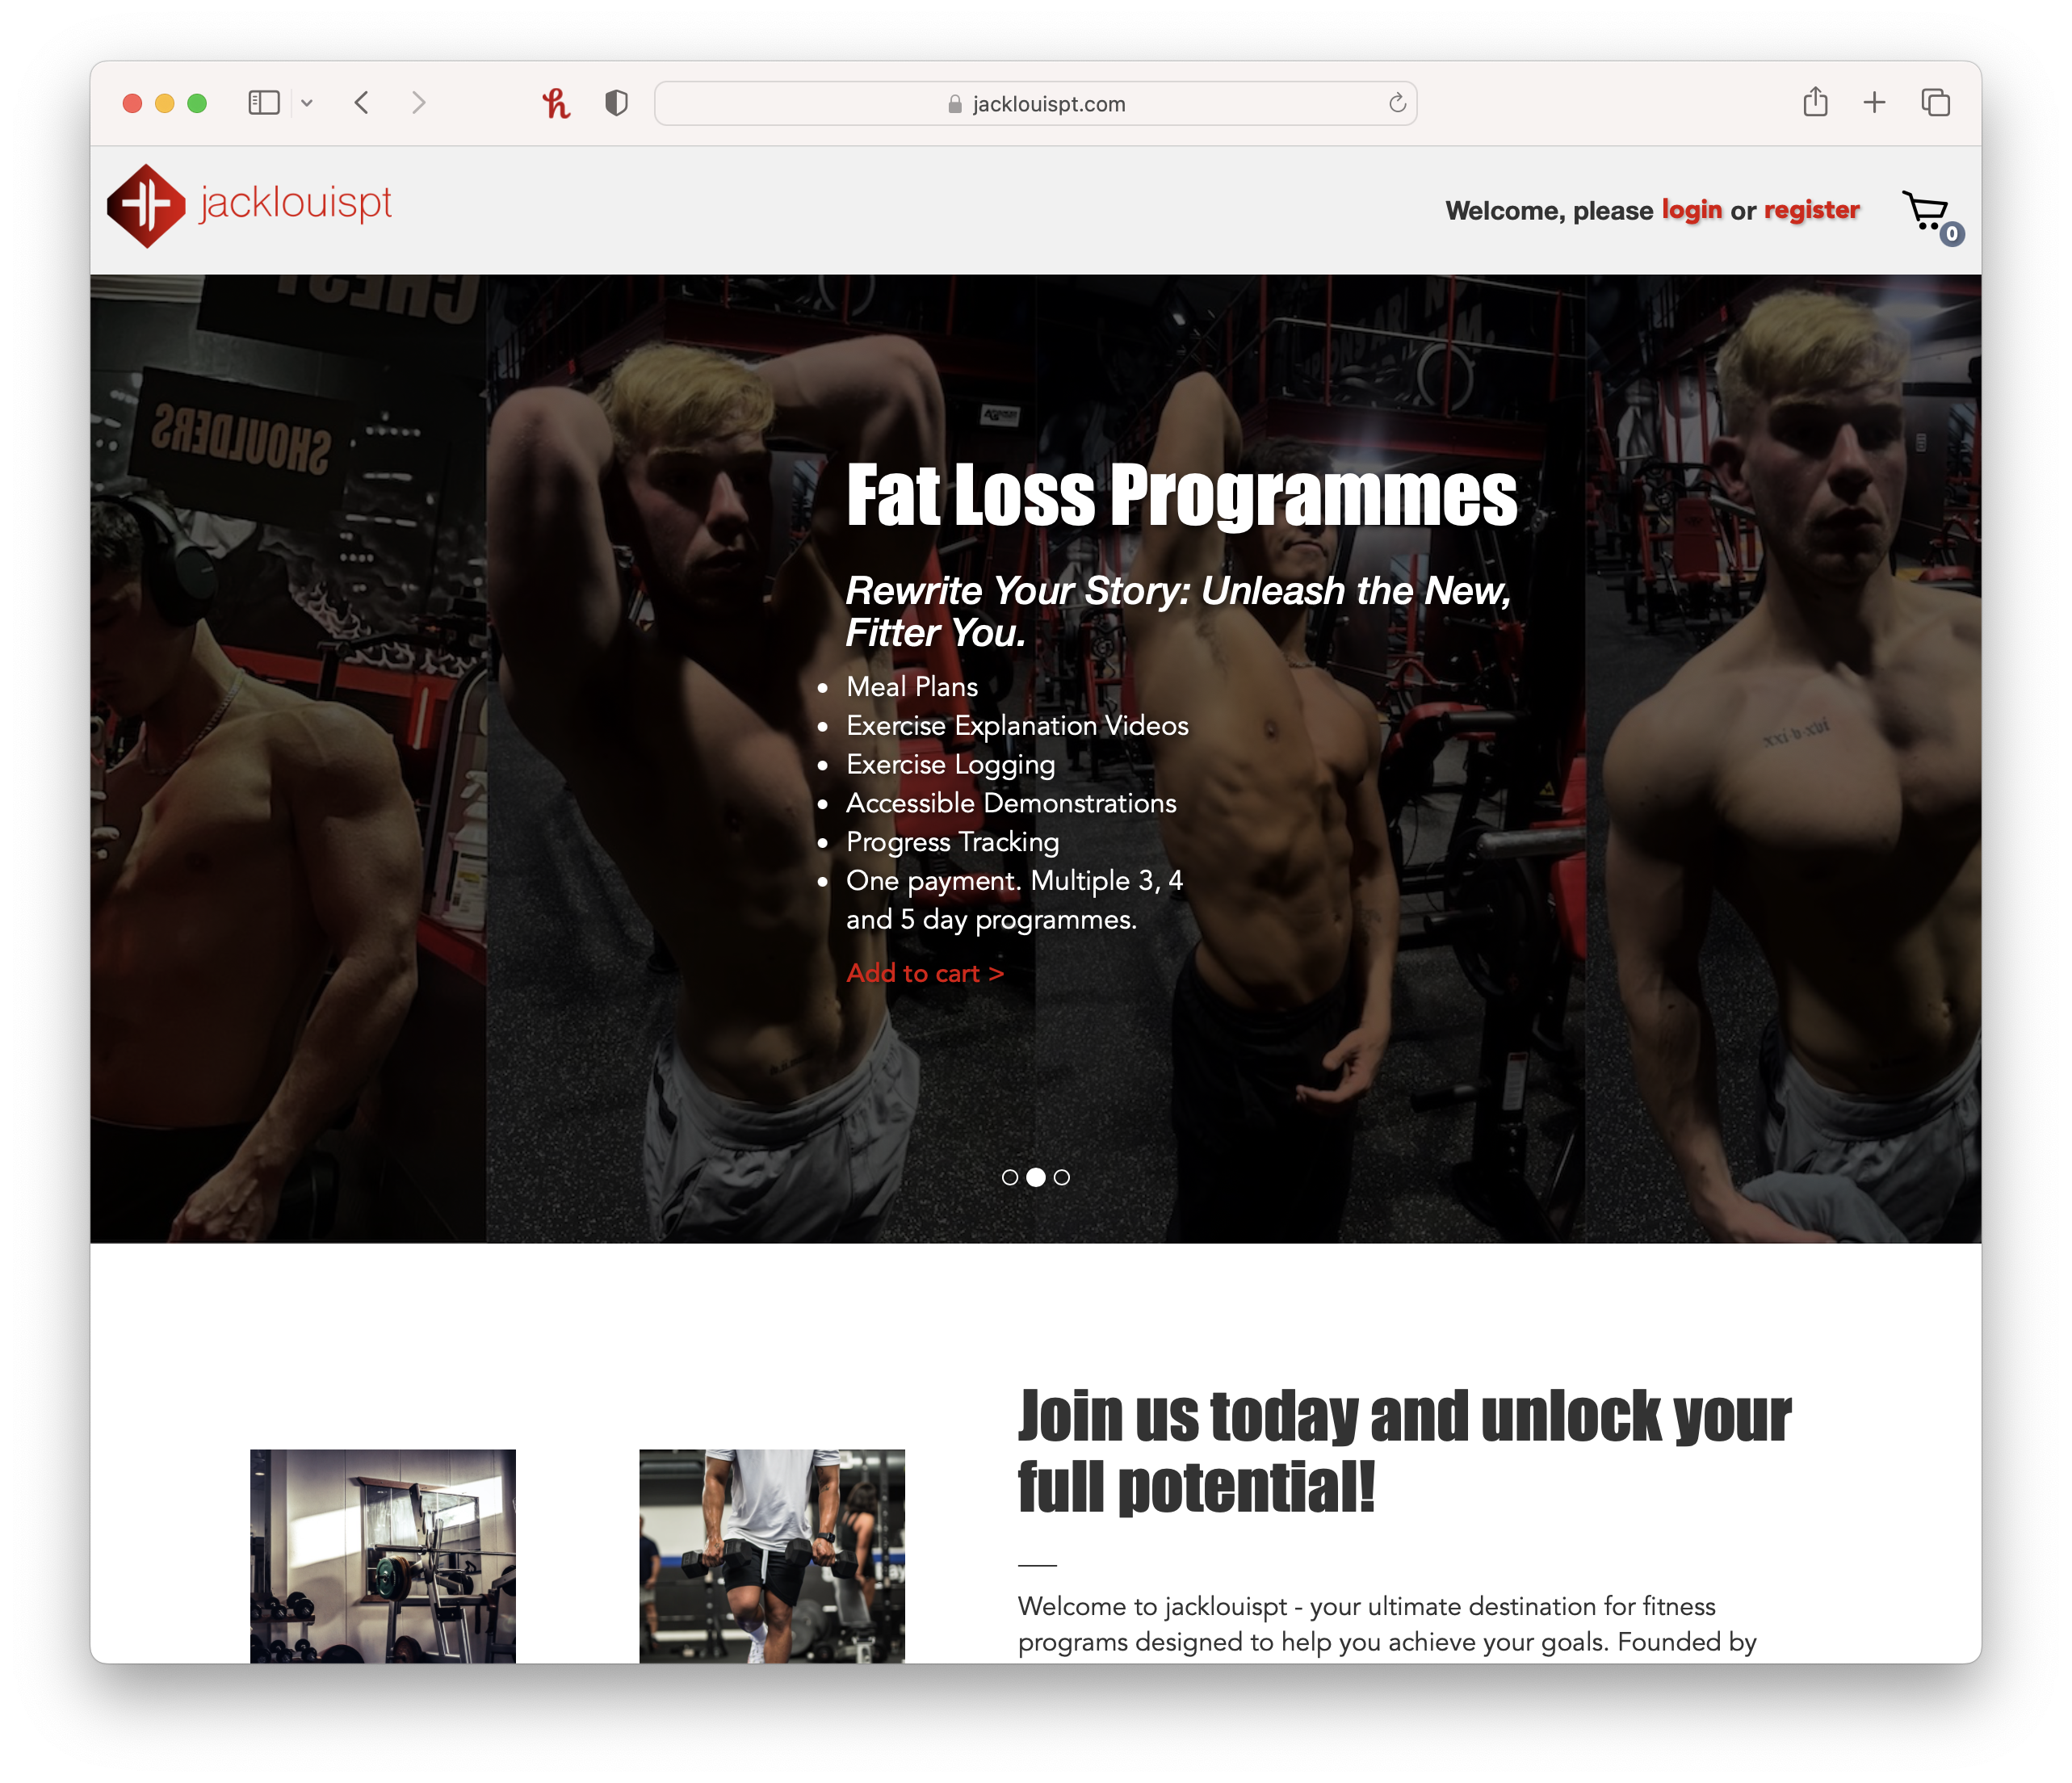

Slide 11
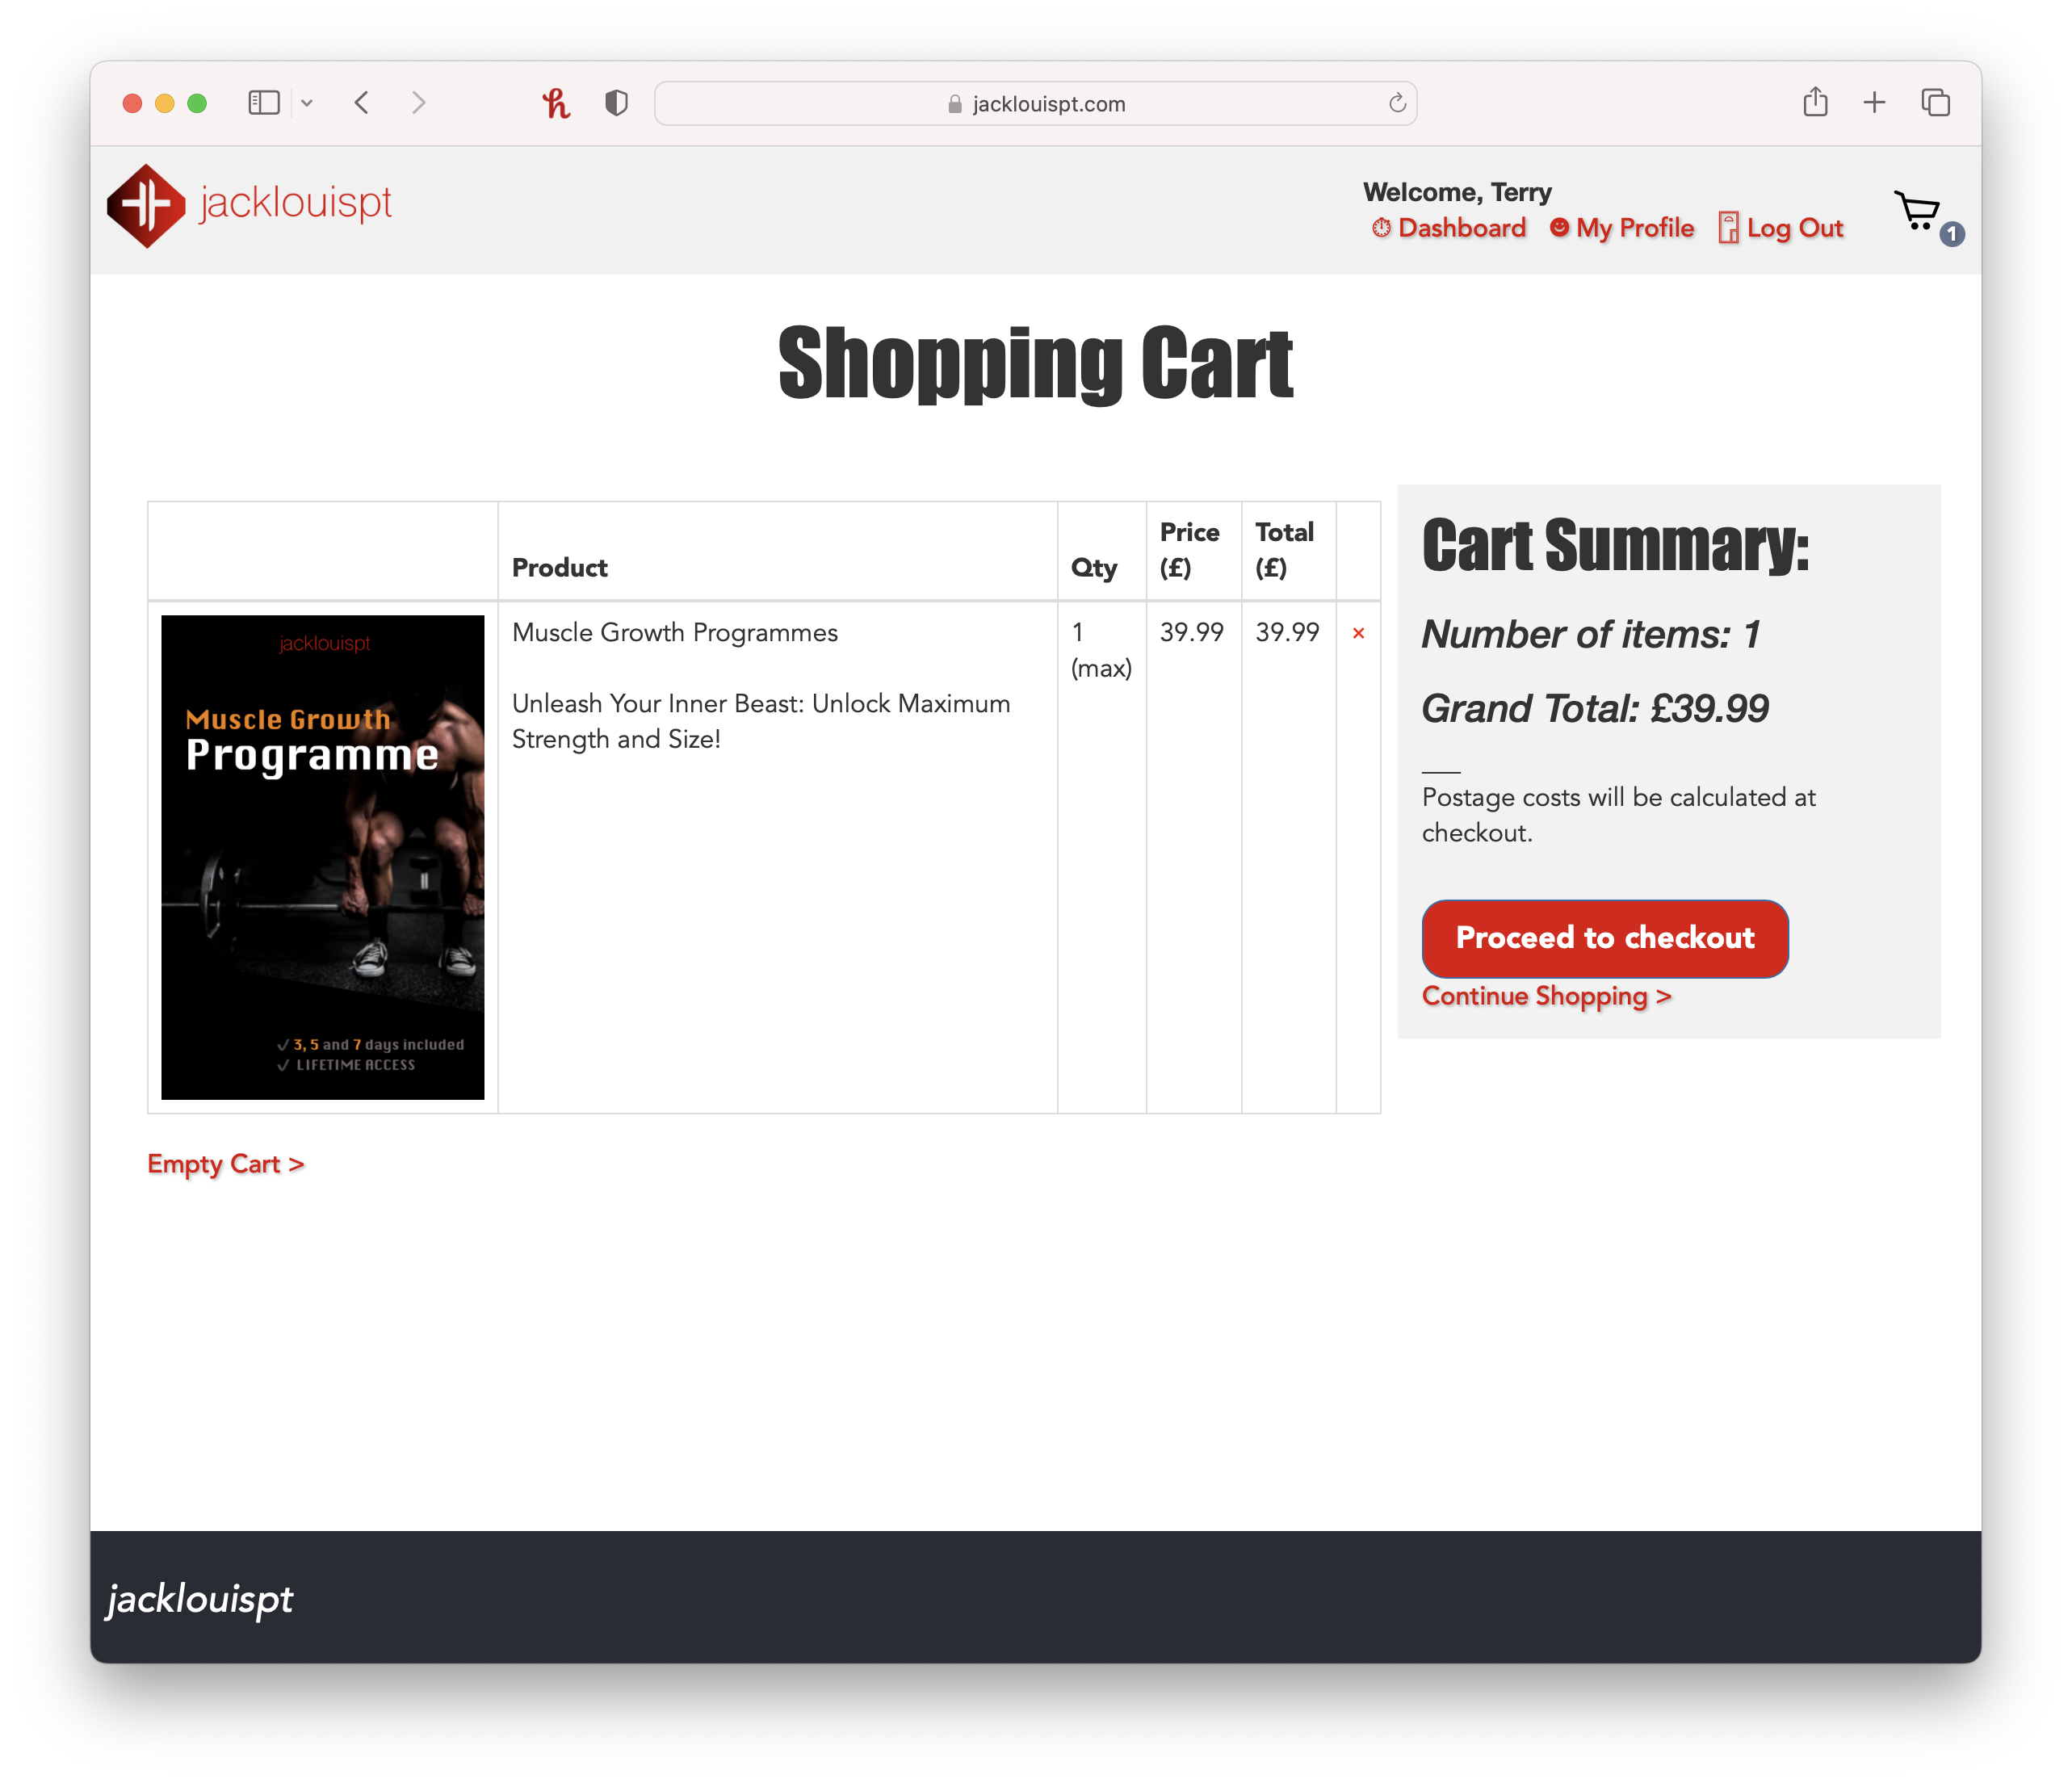
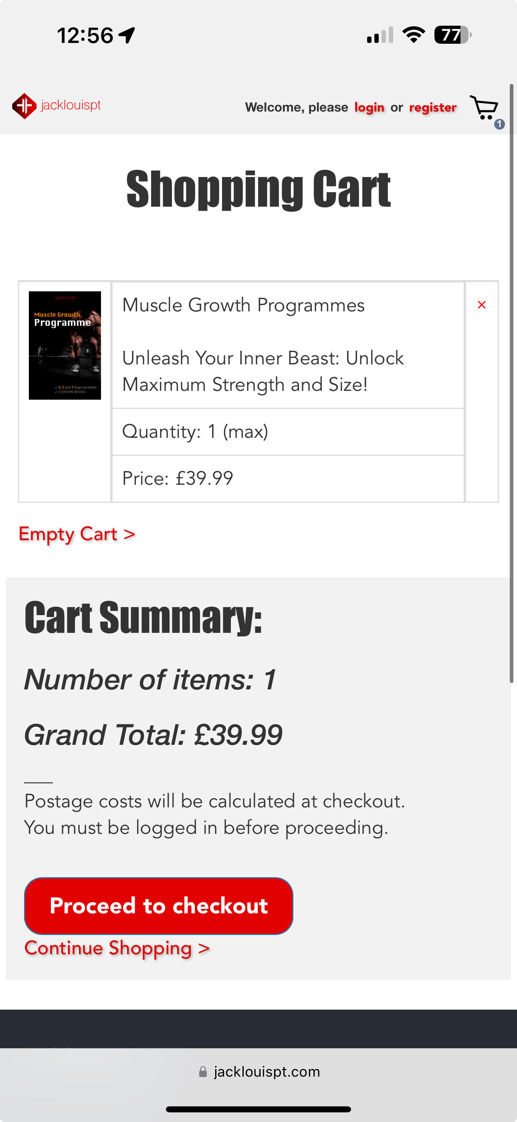

Slide 12


Slide 13
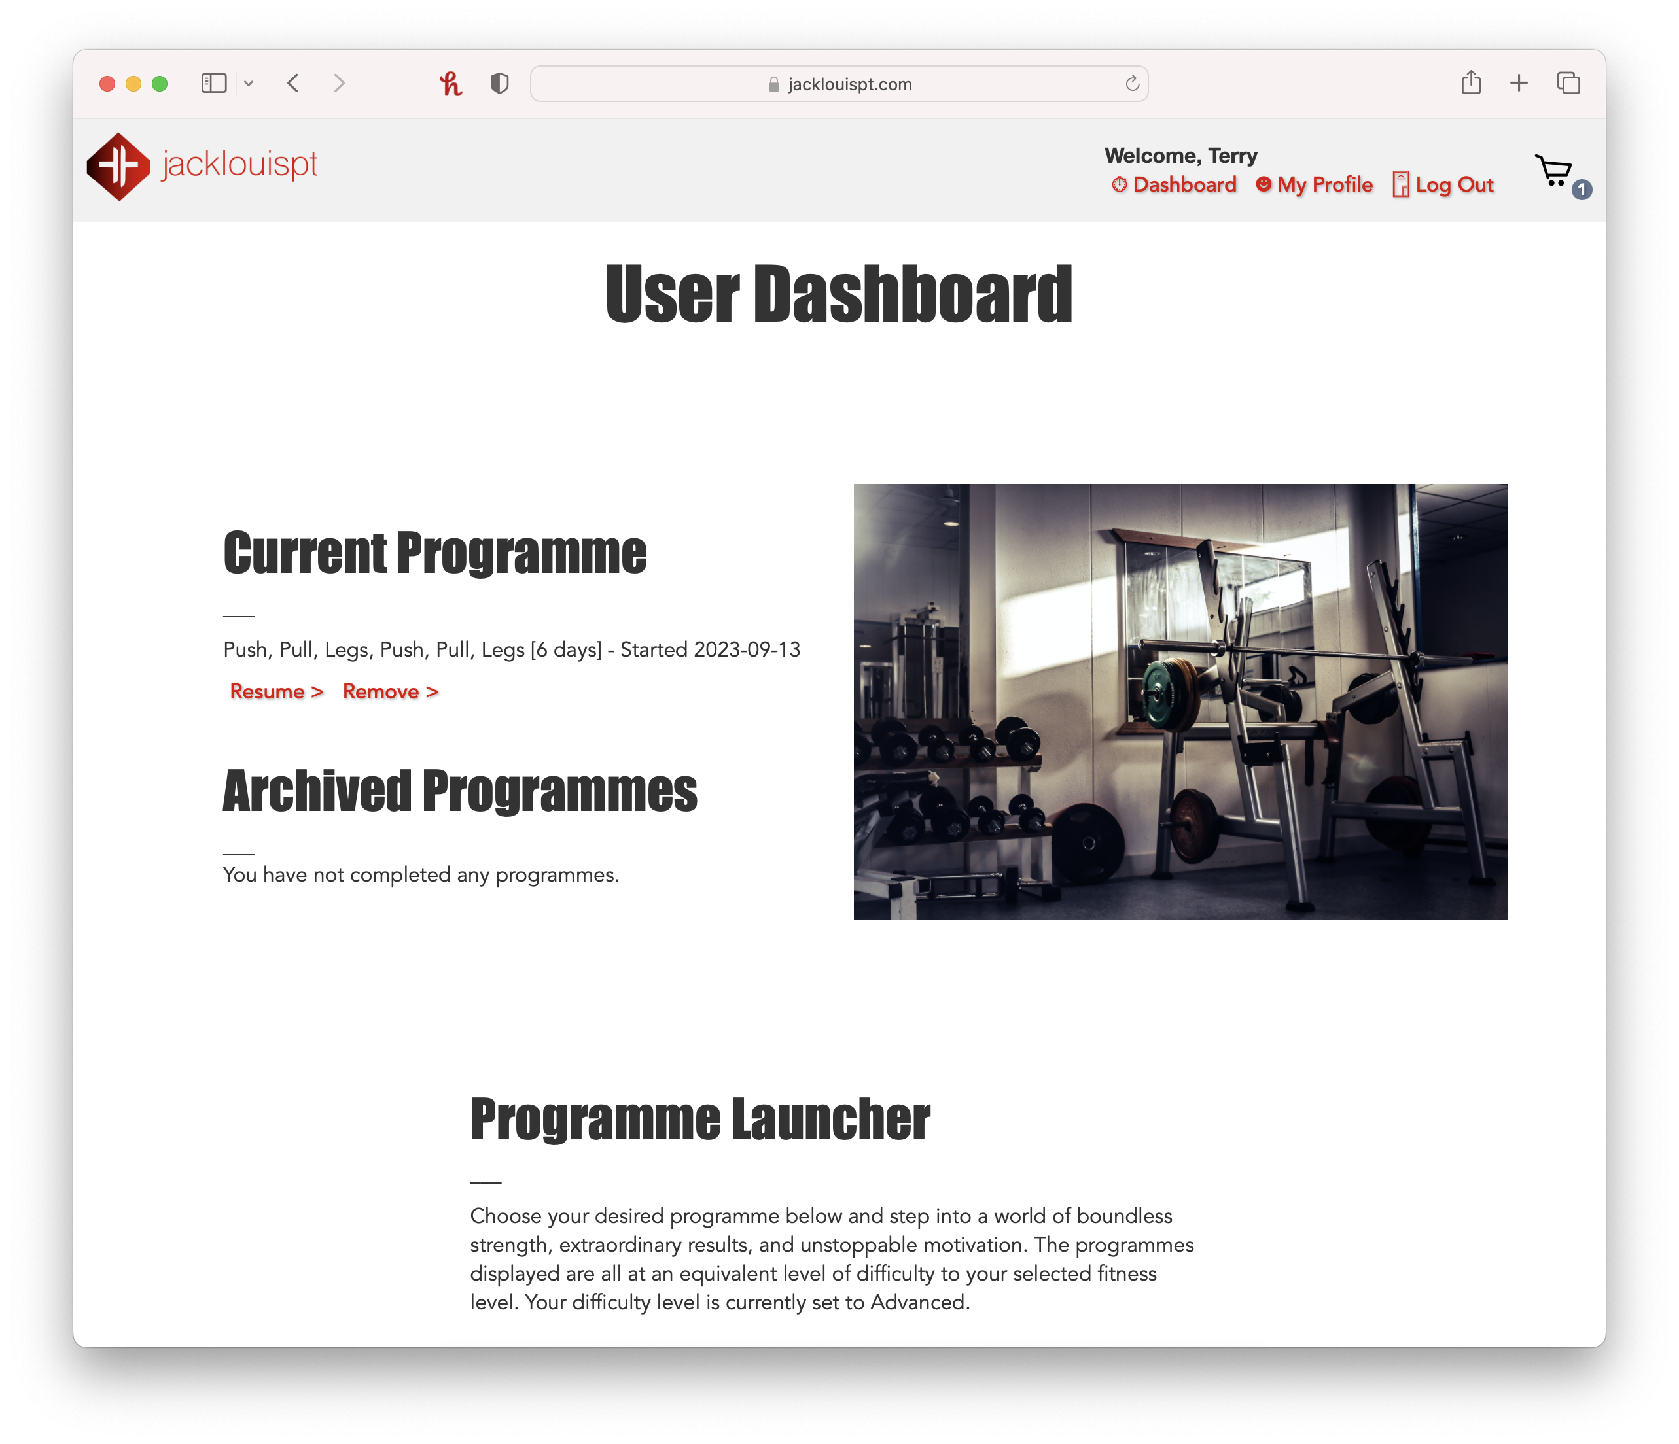

Slide 14
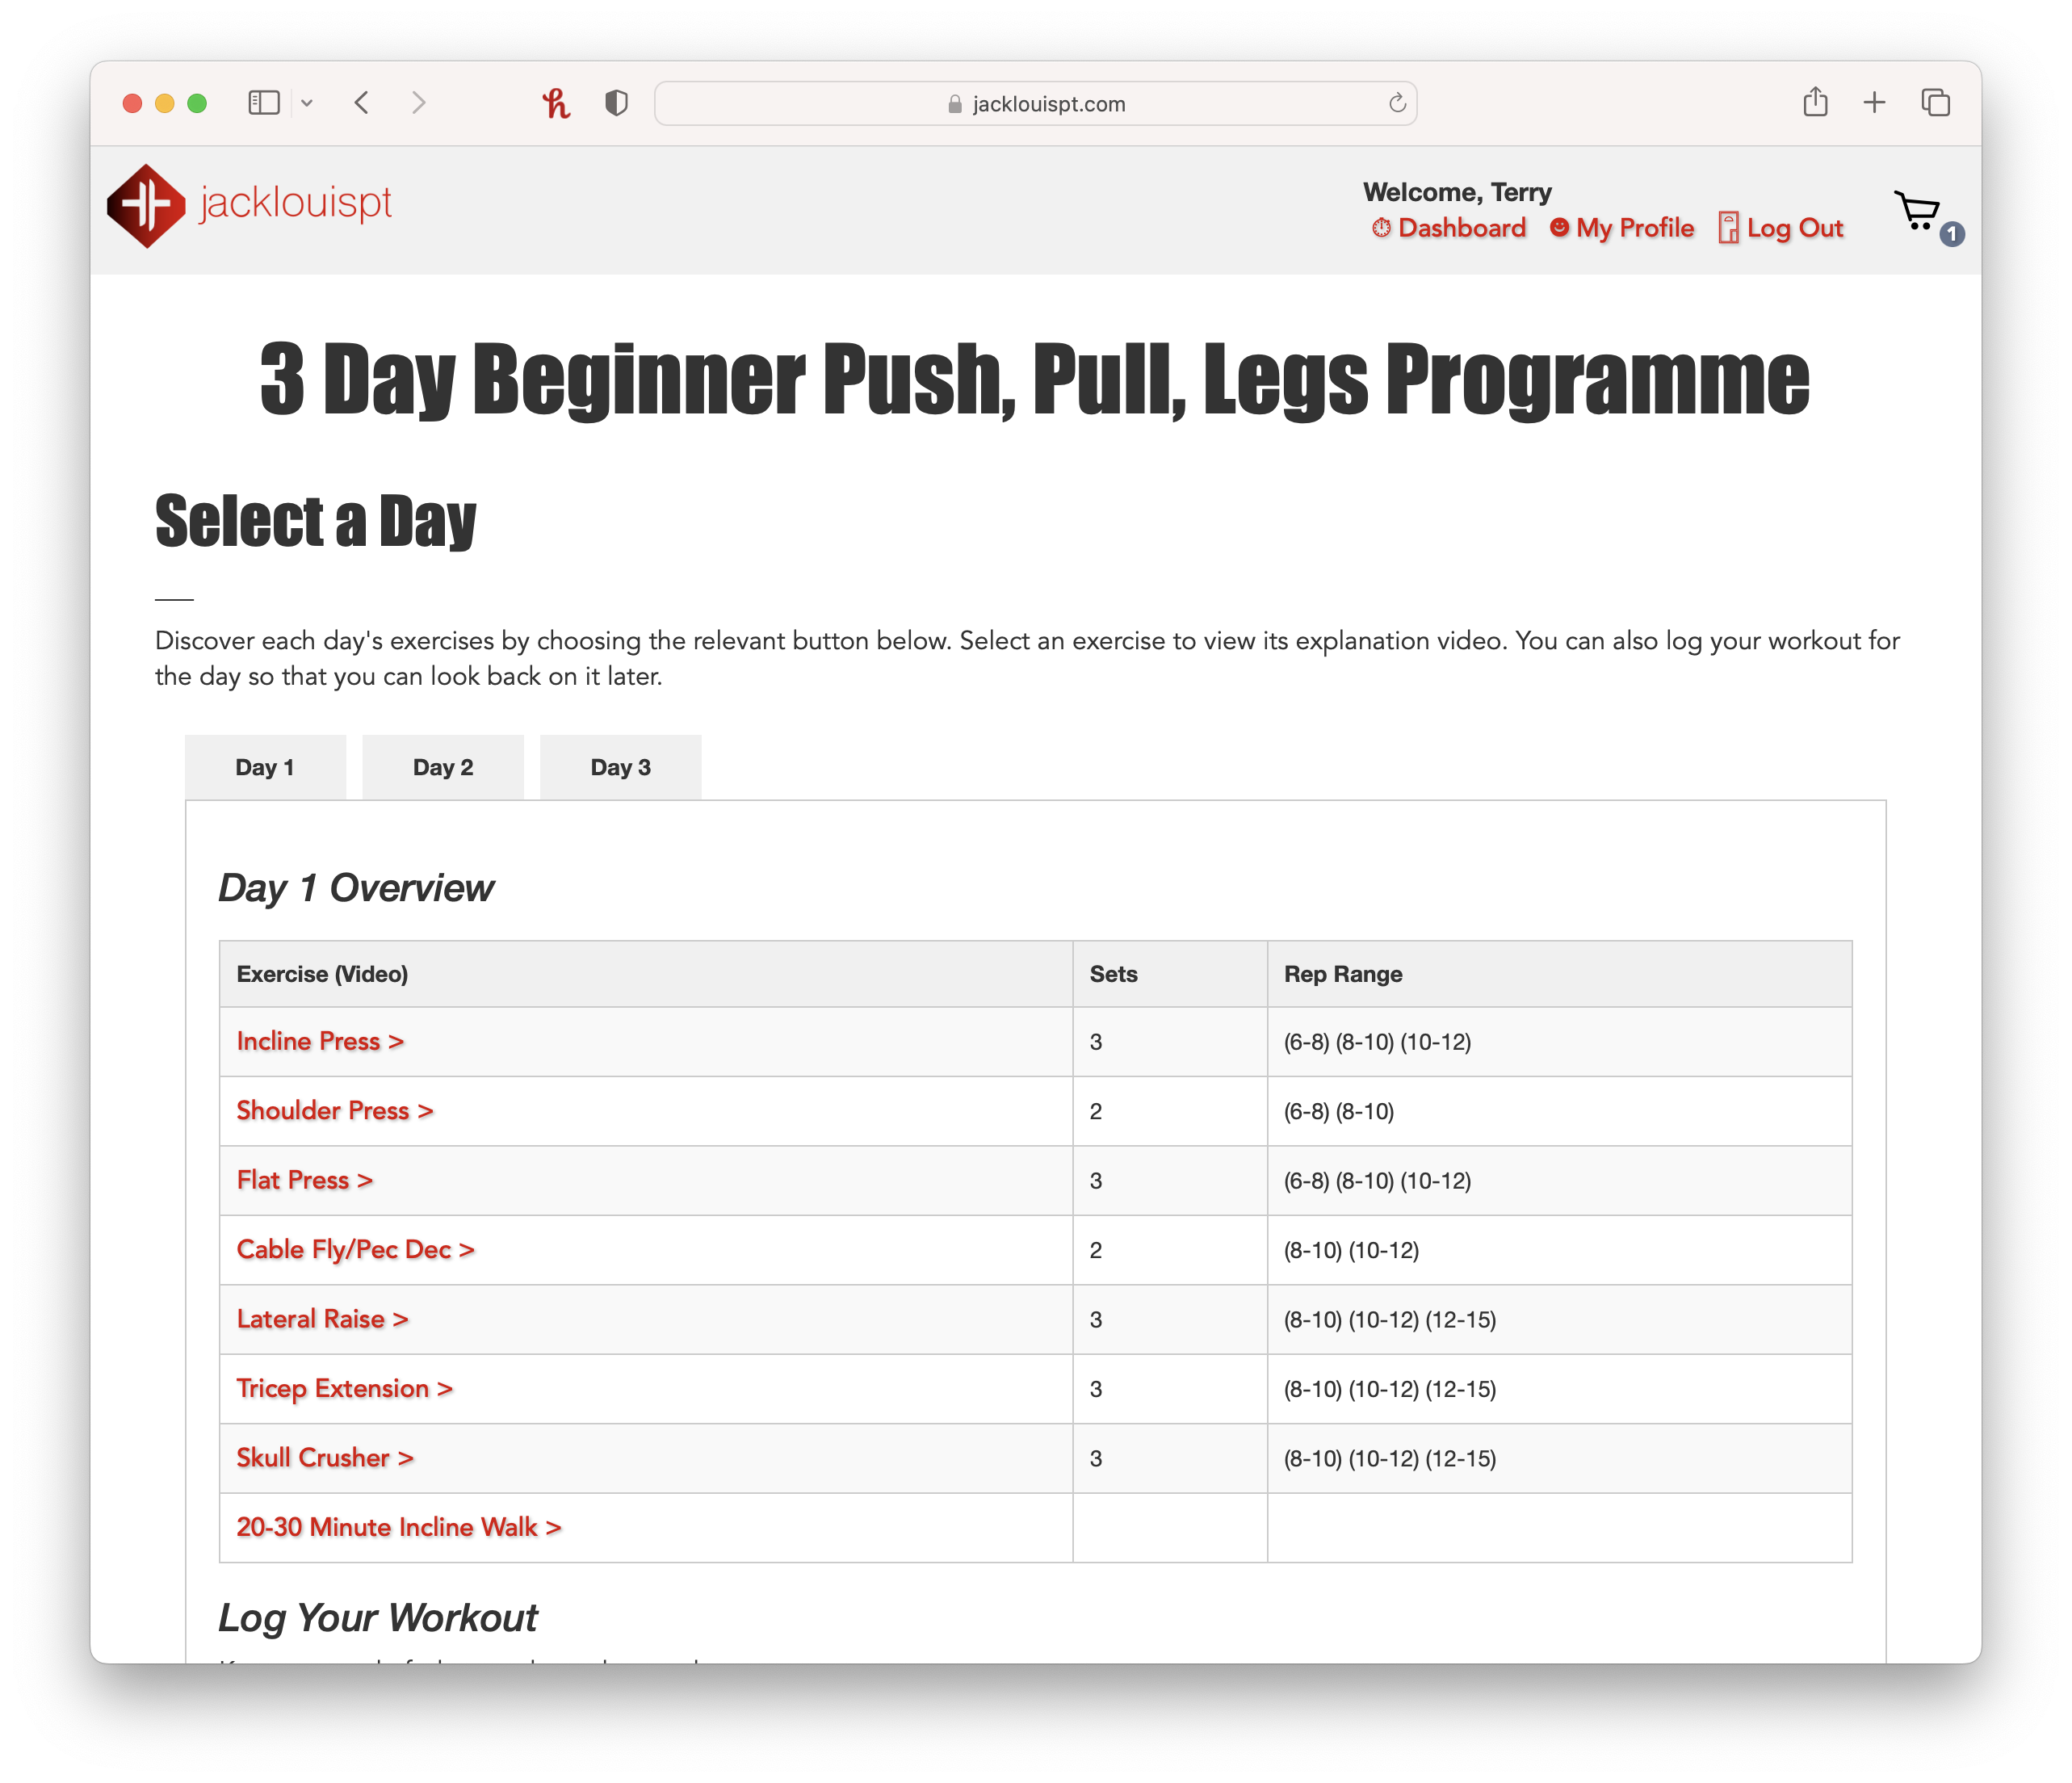

Slide 15
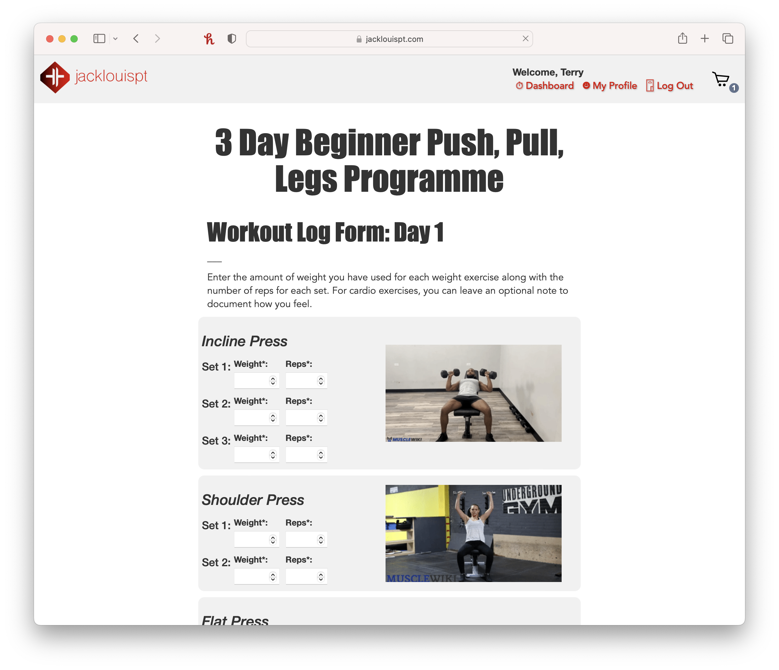

Slide 16
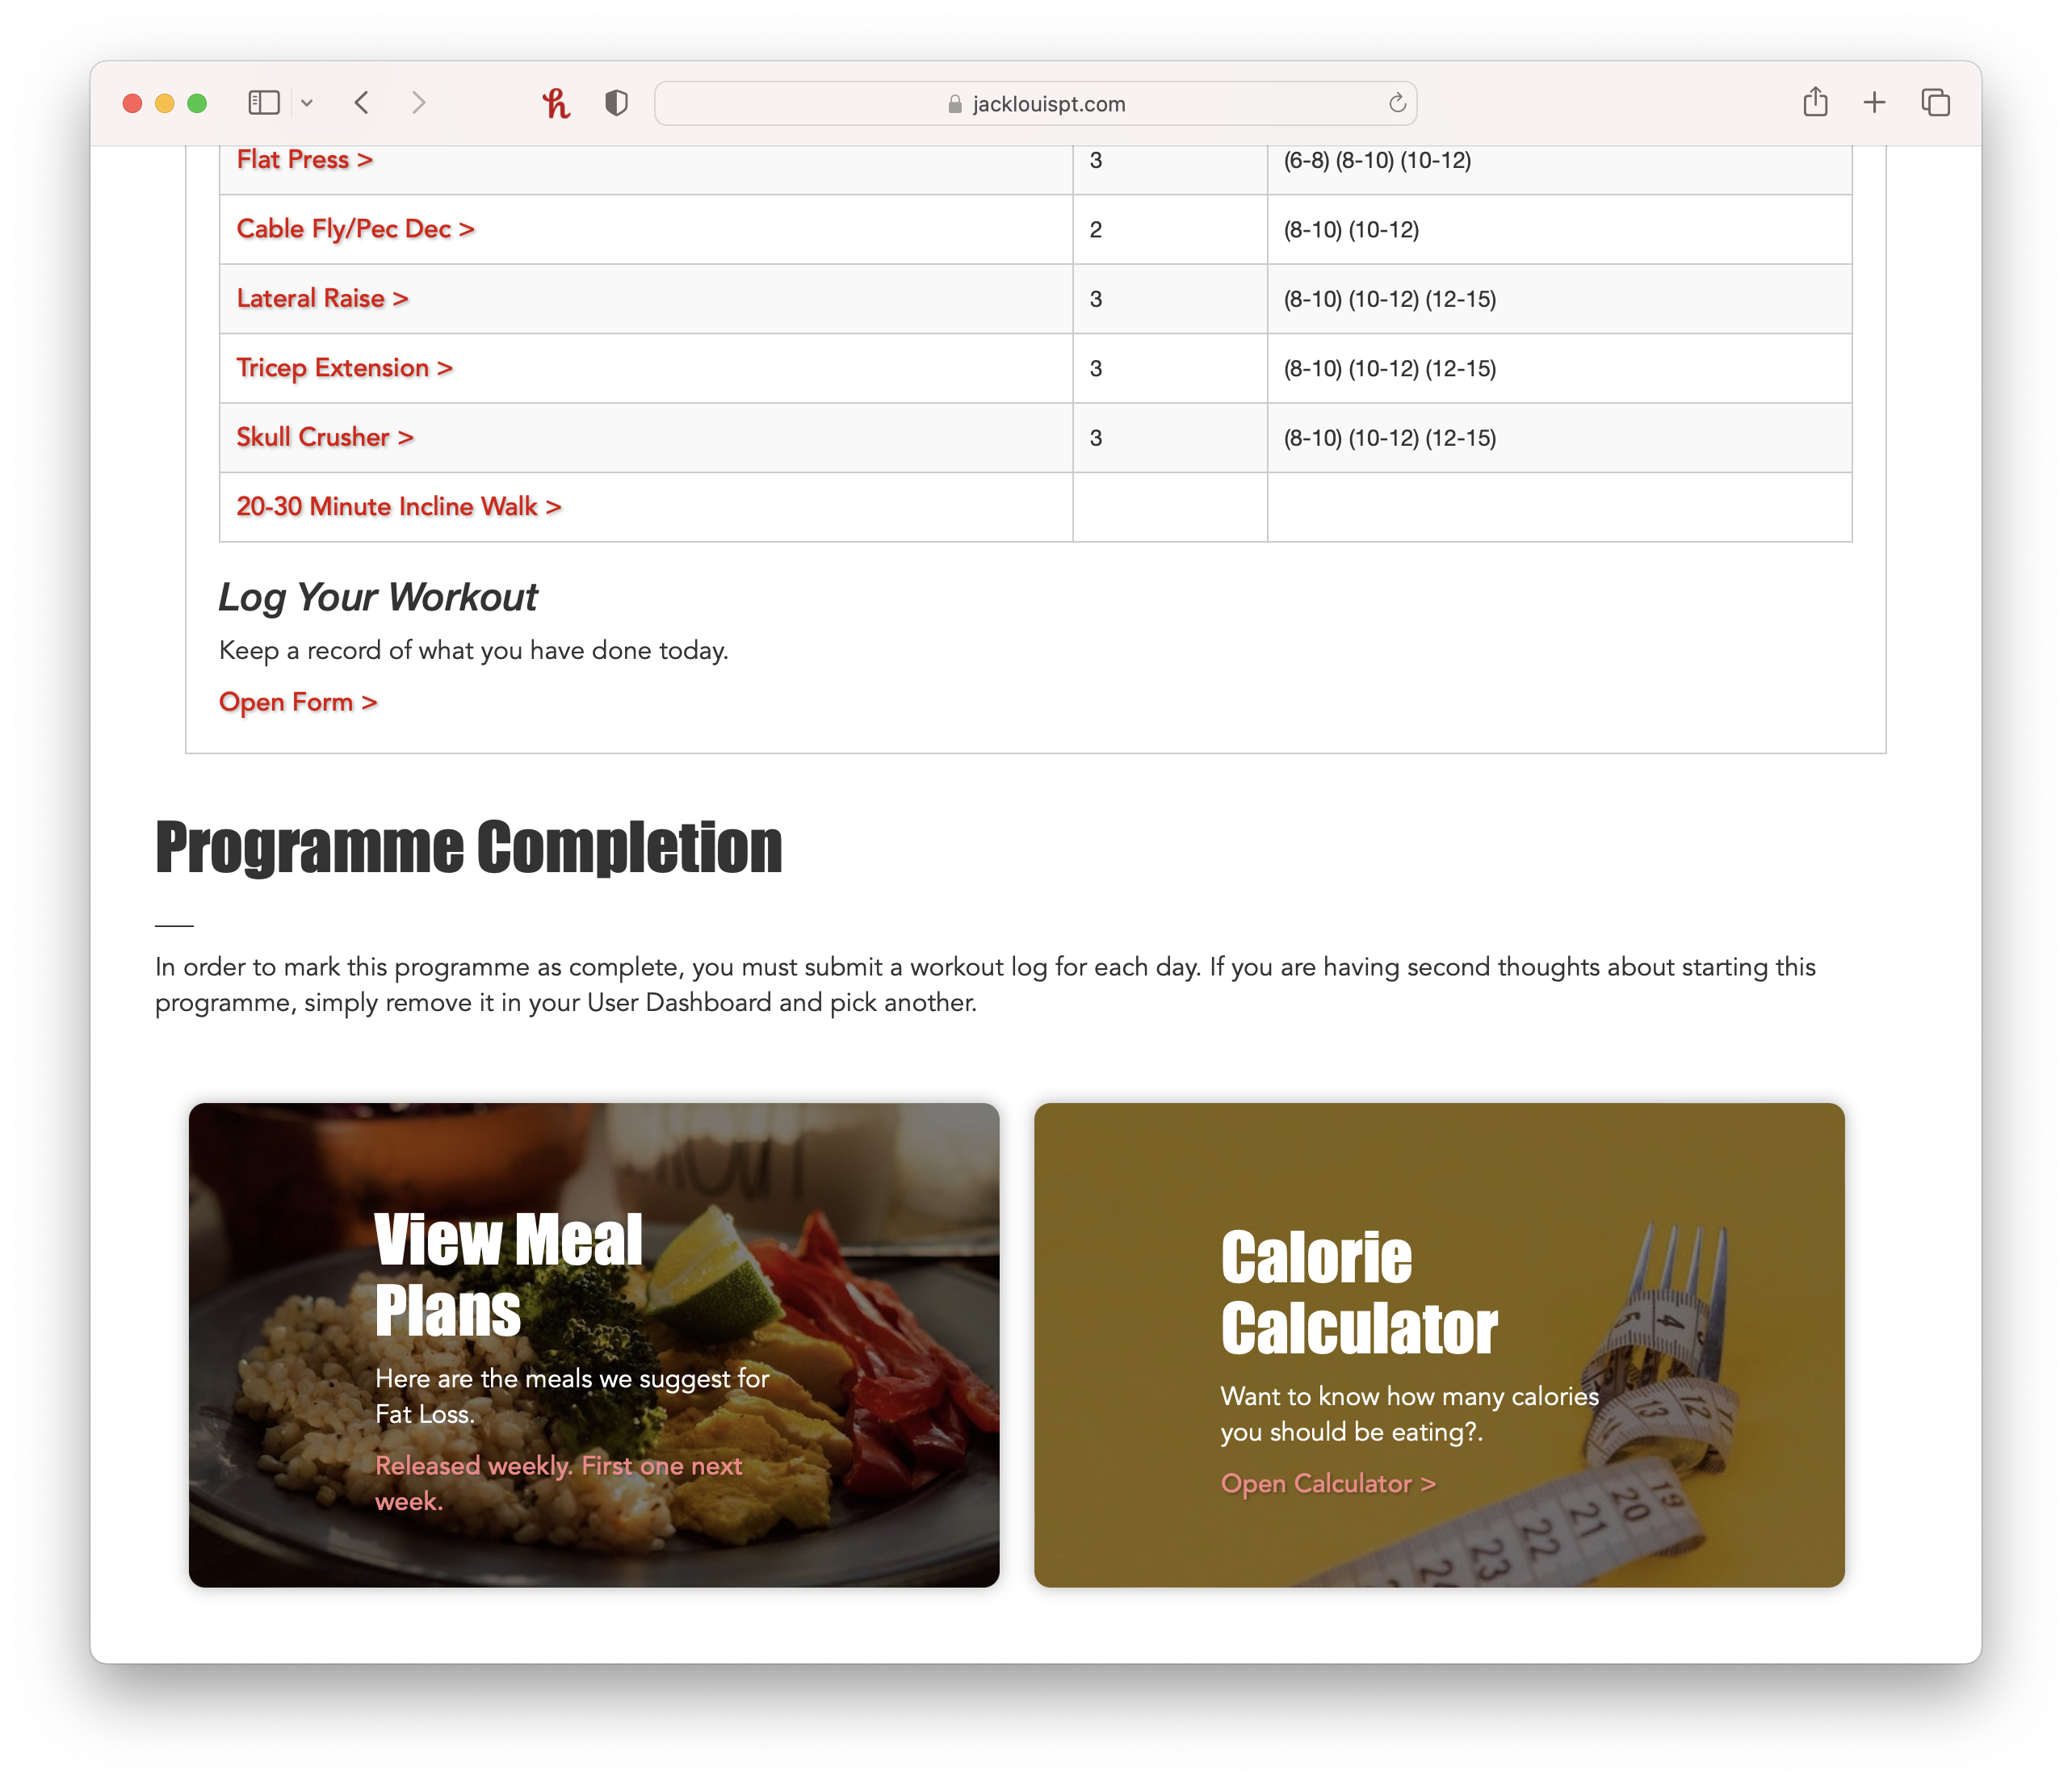

Slide 17
Video
jacklouispt.com

Slide 18
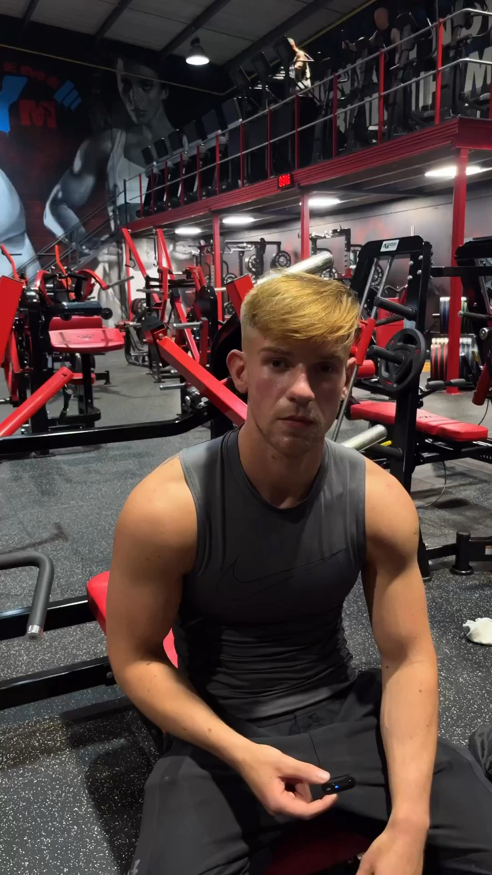
Video
jacklouispt.com

